Slide 1
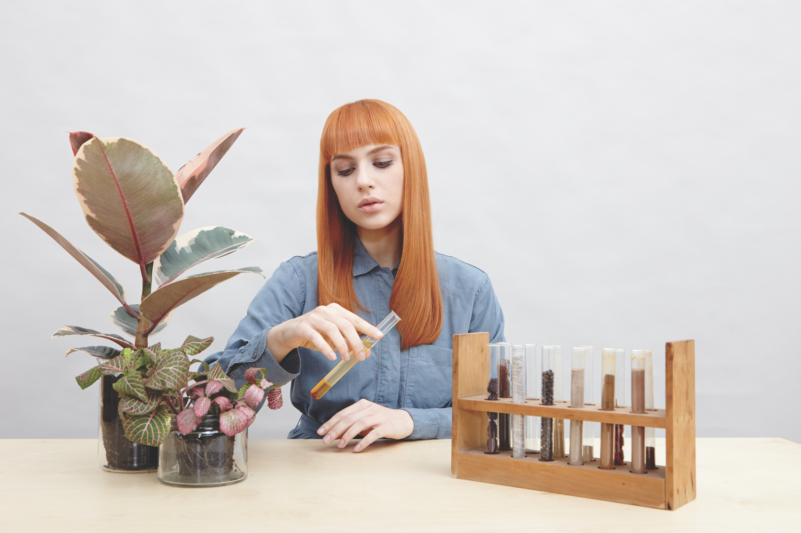

Slide 2


STYLING
PRODUCT
KNOWLEDGE

Slide 3
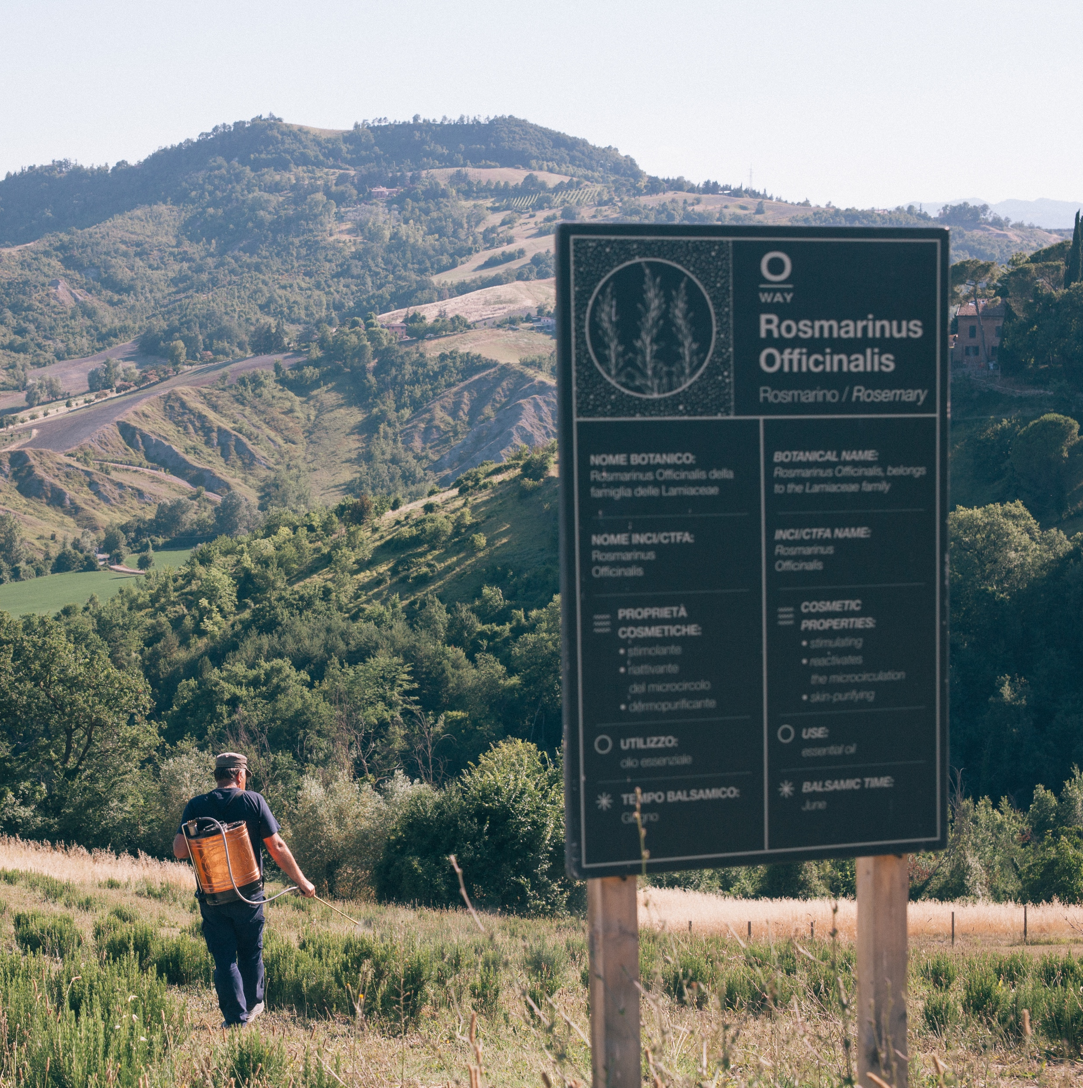
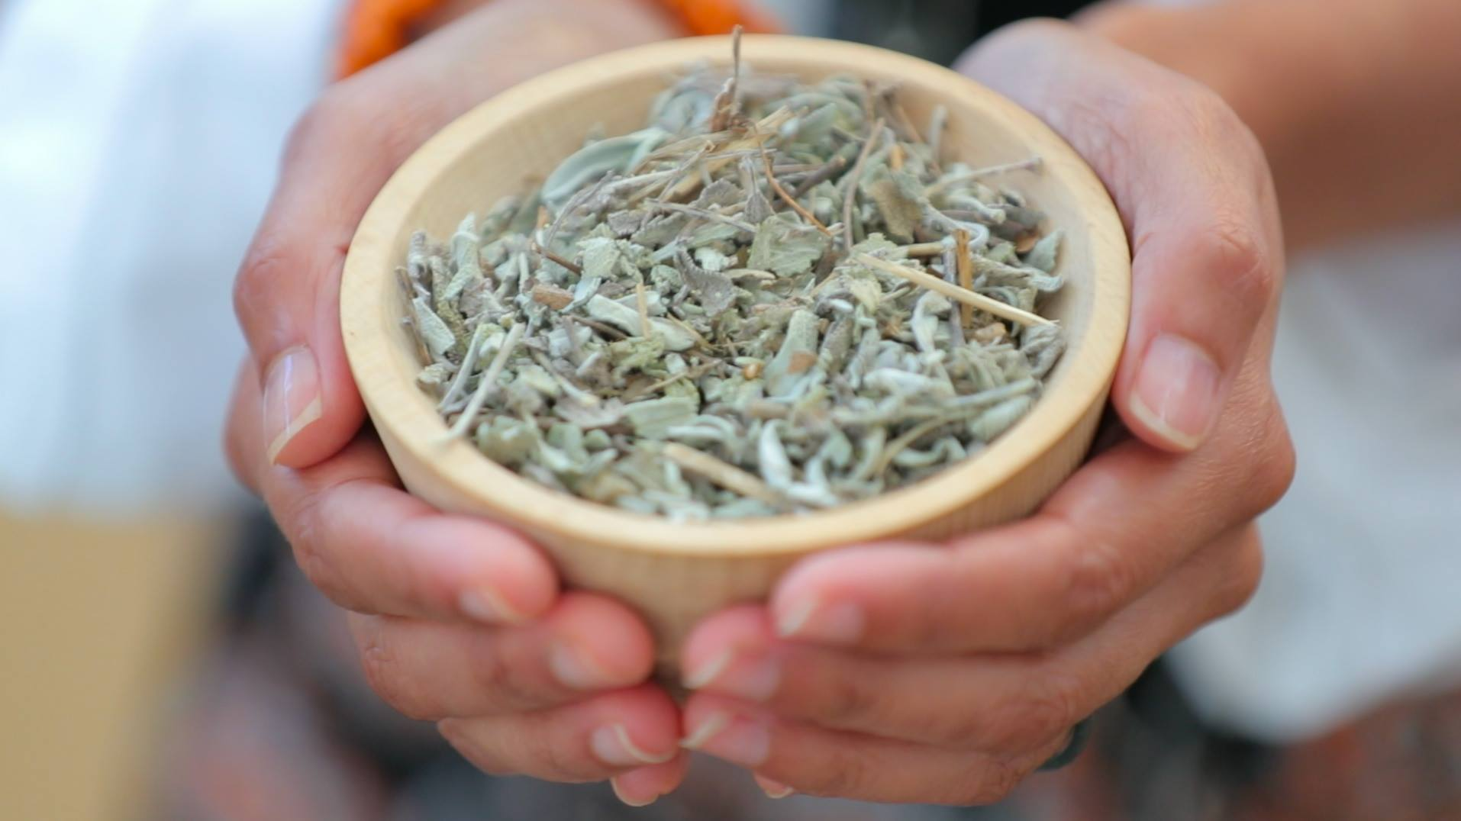
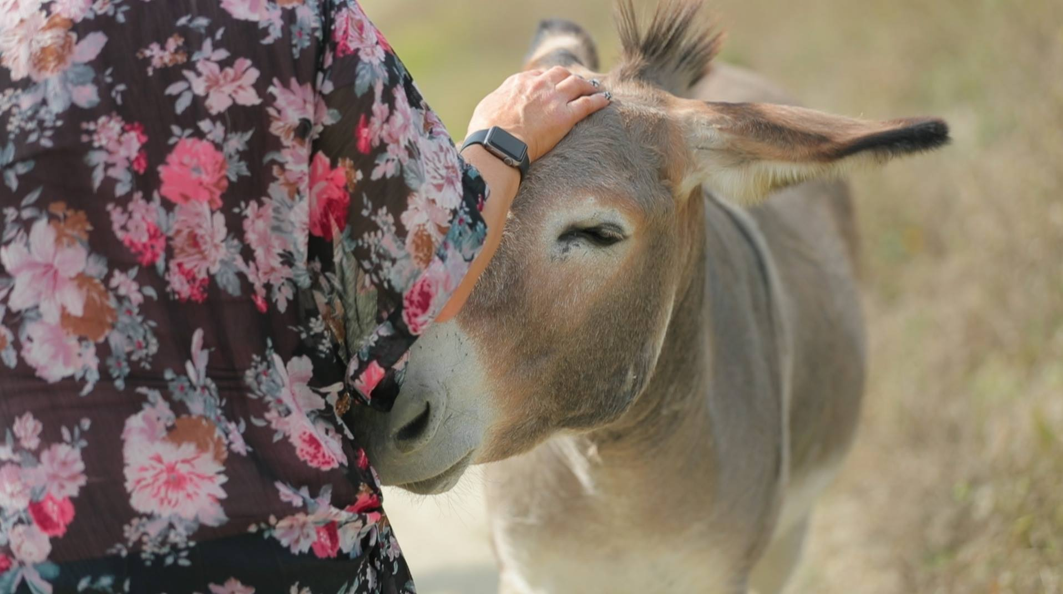


FROM FARM TO CHAIR
Biodynamic farming produces the most ethical and effective botanicals for our professional formulas.
OWAY ORTOFFICINA
BOLOGNA, ITALY

Slide 4
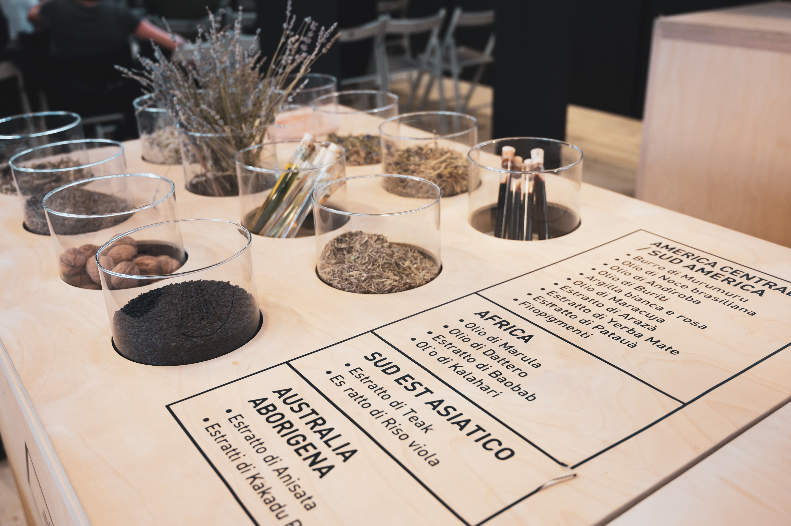
BIODYNAMIC INGREDIENTS
A STEP ABOVE ORGANIC
HOLISTIC
HARMONY
ETHICAL
EFFECTIVE
ECOLOGICAL
ZERO CHEMICALS

Slide 5
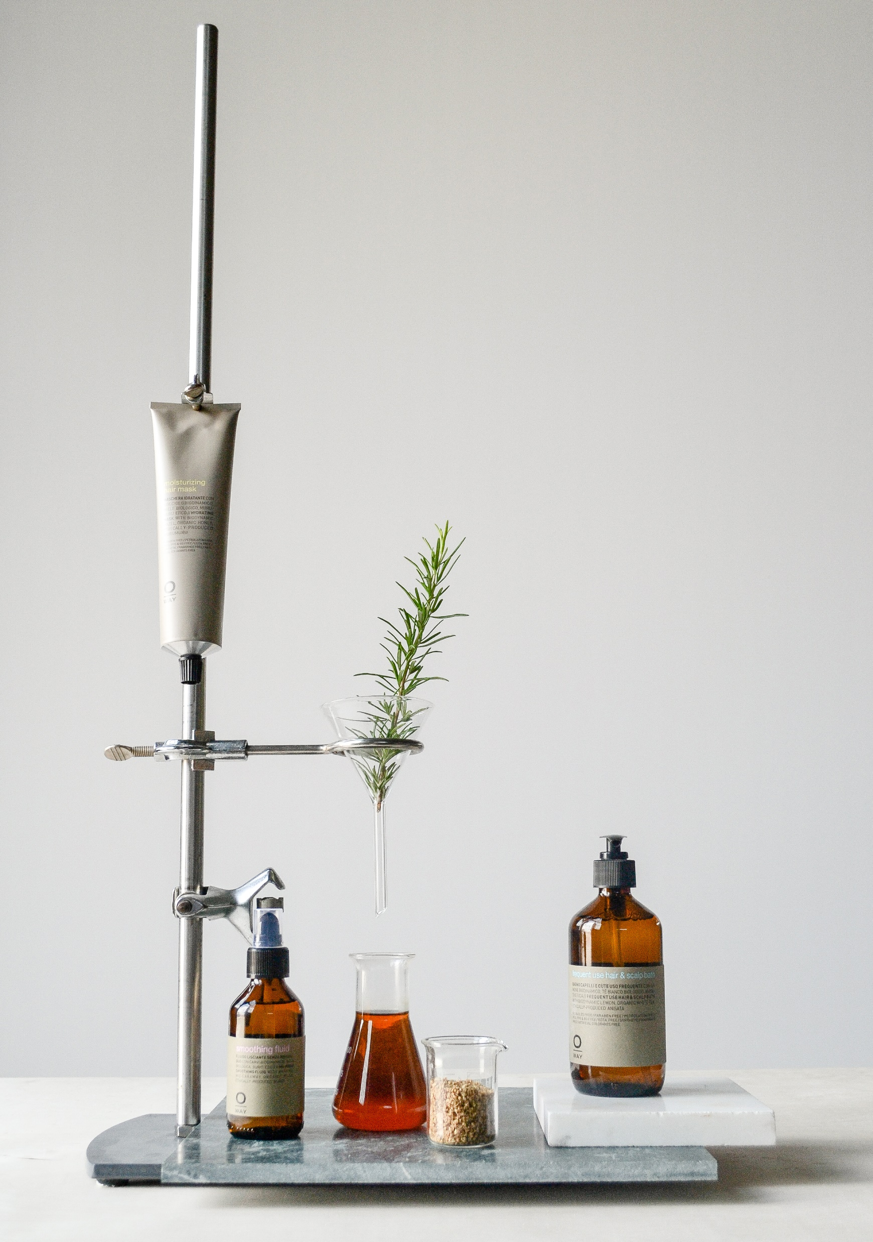
GREEN CHEMISTRY
PERFECTION OF NATURE AND PERFORMANCE
Oway formulates using the highest concentration of biodynamic, organic, and naturally derived ingredients.

Slide 6

FAIR TRADE NETWORKS
Plants sourced from ethically managed crops with more than 800 partnerships around the world.
Fair Wages
Safe Working Conditions
Environmentally Responsible

Slide 7
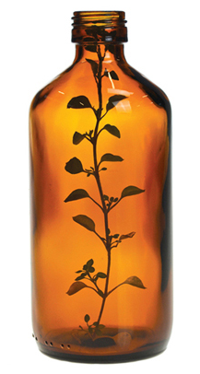
SUSTAINABLE LUXURY
LESS PACKAGING = ECO-FRIENDLY.
Amber glass ensures absolute ingredient integrity and preservation of our precious active botanicals.

Slide 8
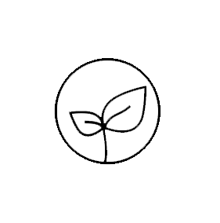
STYLING
NON-TOXIC, ECO STYLE
WITHOUT
PARABENS // SYNTHETIC FRAGRANCE // PETROLEUM //
PPG, PEGs/BG // SULFATES // ARTIFICIAL COLORANTS

Slide 9
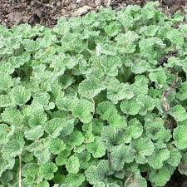
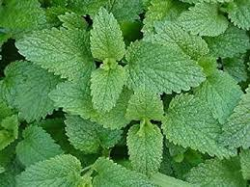
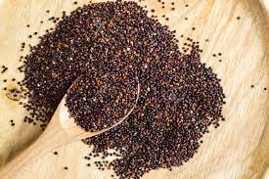
INFINITE STYLING EXPRESSIONS
ACTIVE INGREDIENTS
BIODYNAMIC WHITE HOREHOUND
BIODYNAMIC LEMON BALM
ORGANIC BLACK QUINOA

Slide 10
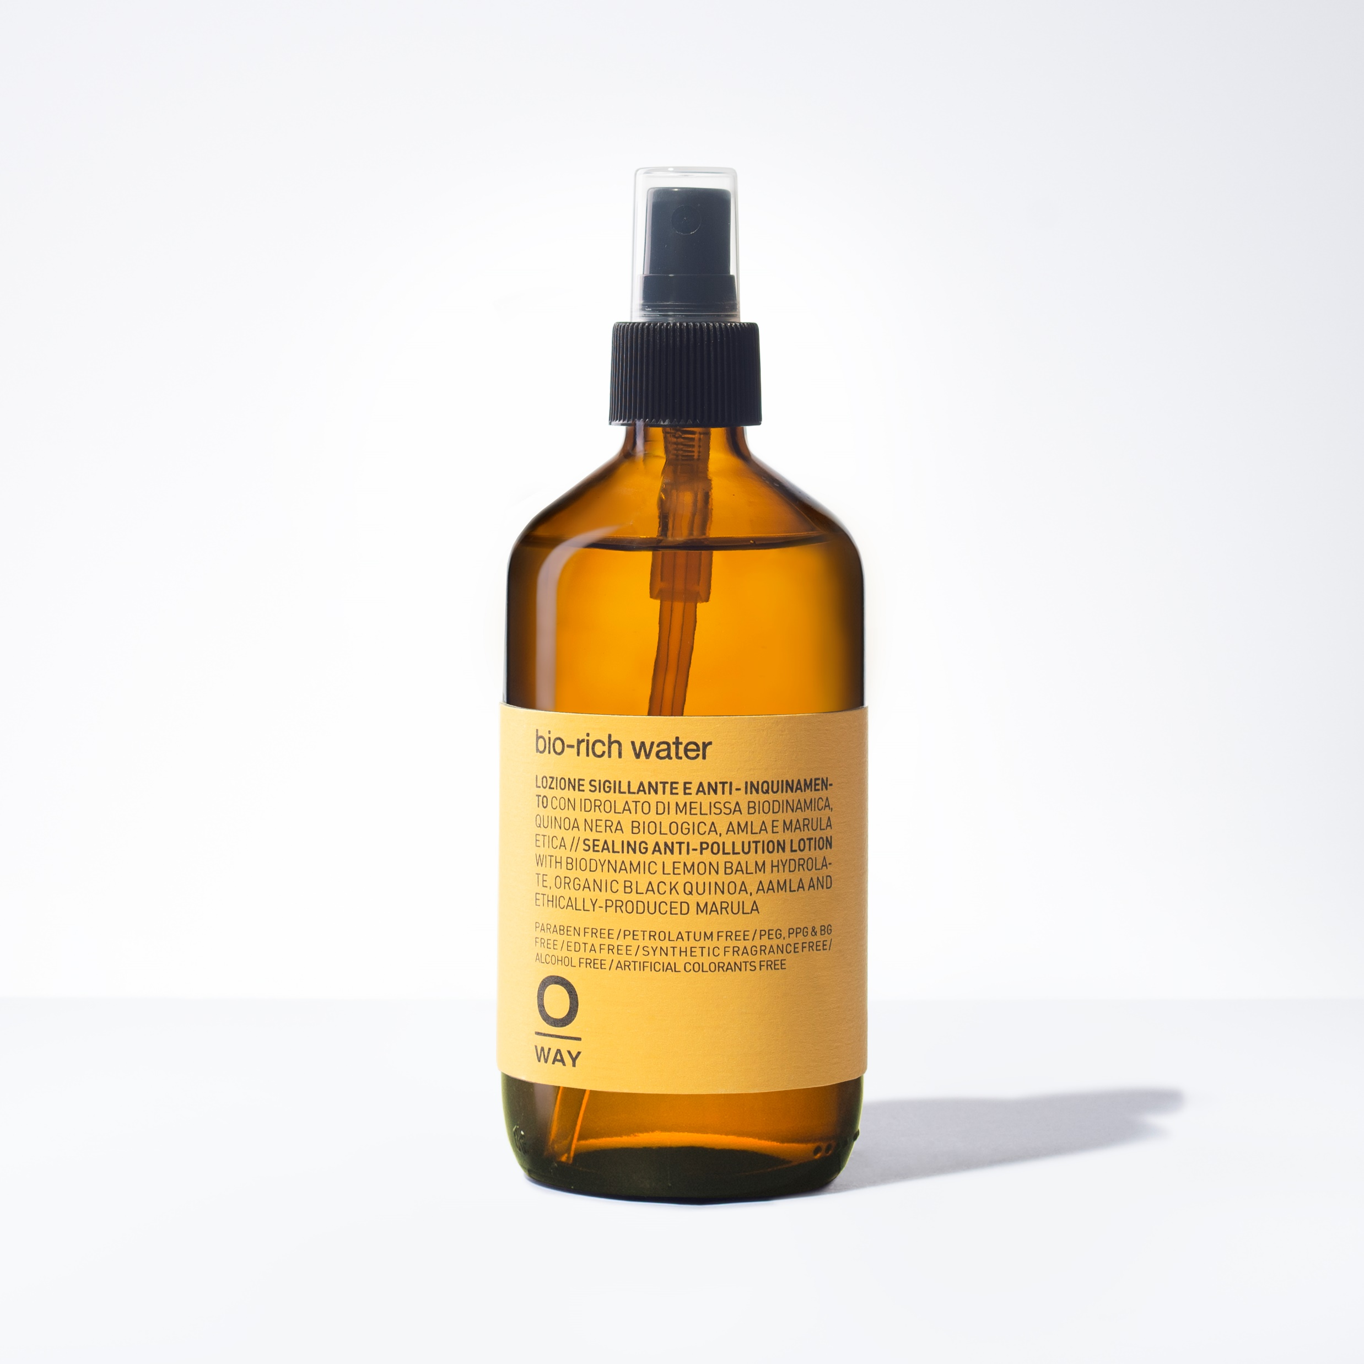



BIO-RICH WATER
Nourishing Cutting Spray
HOLD 0.0
SHINE 0.0
+ GREAT HYDRATING CUTTING SPRAY
+ LIGHT MOISTURE SPRAY FOR HAIR & BODY
+ PROTECTS AGAINST EXTERNAL POLLUTANTS
+ MAKE UP SETTING SPRAY OR A ROOM SPRAY
DID YOU KNOW: Mixing with BOHO pomade can better sculpt the hair without weighing it down.

Slide 11
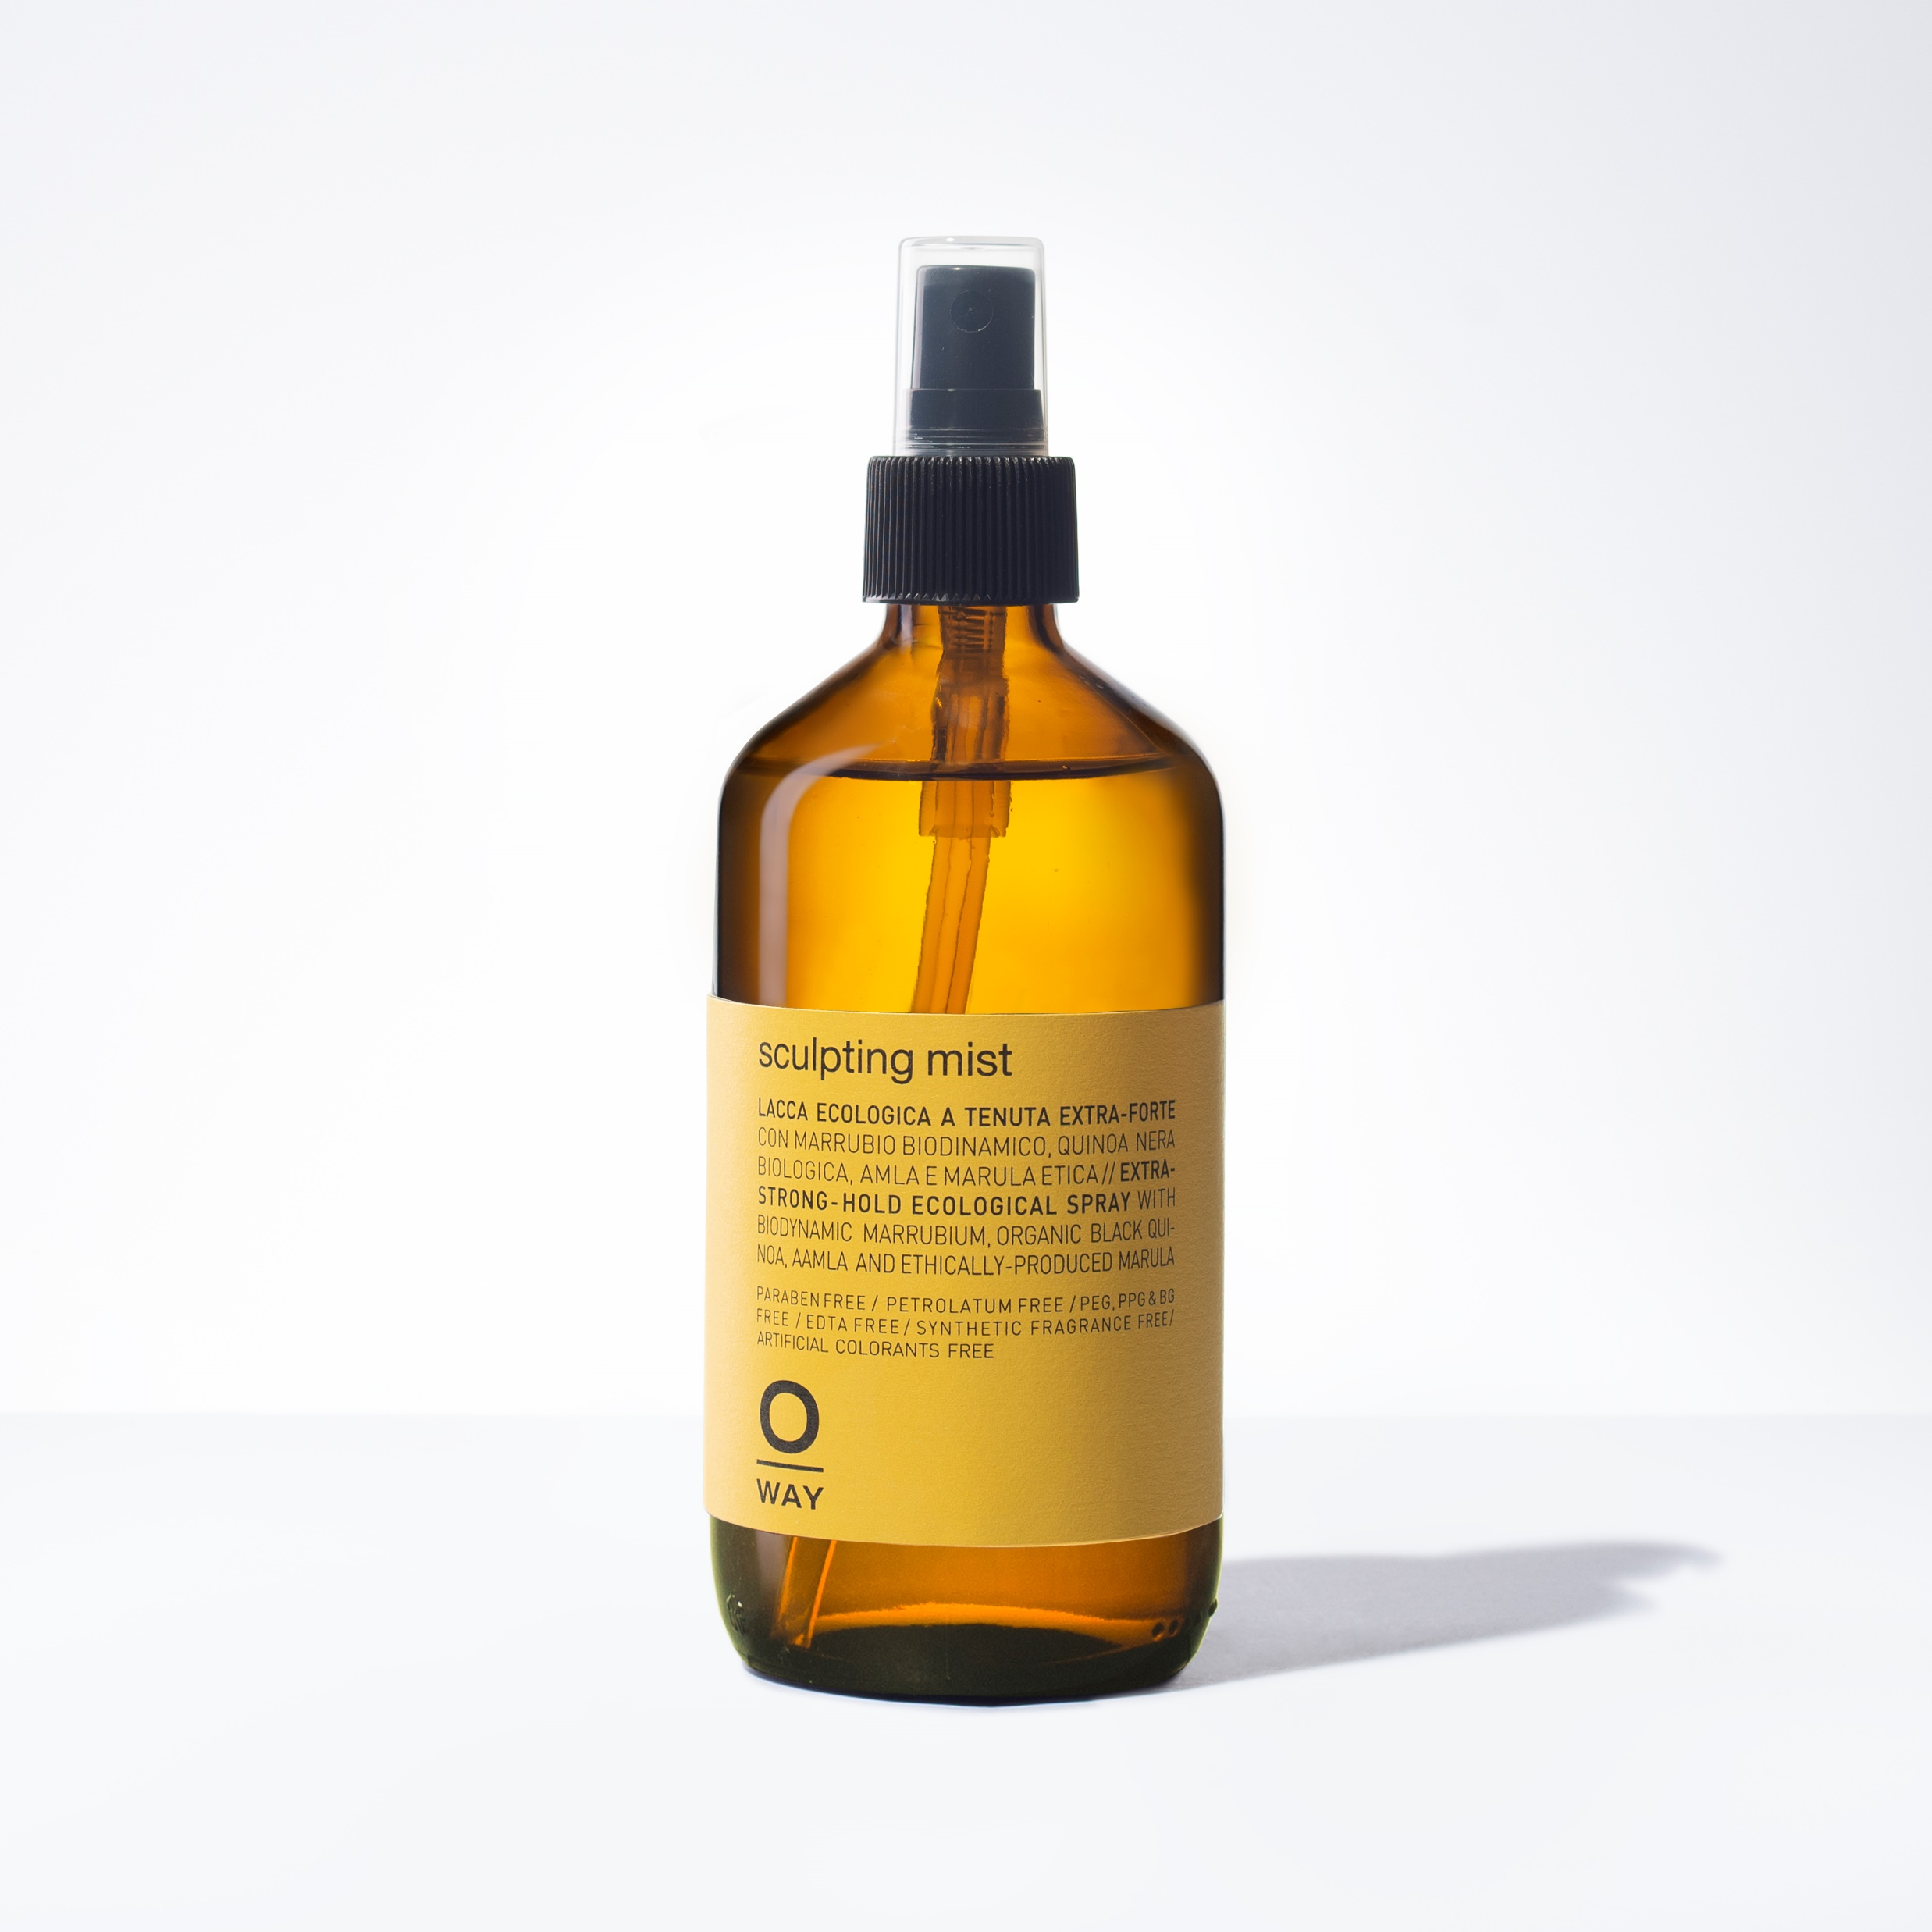
SCULPTING MIST
Strong Hold, Eco-friendly Hair Spray
HOLD 6.0
SHINE 4.0
+ FIRM HOLD HAIR SPRAY
+ ADDS CONTROL TO ALL HAIRSTYLES
+ PERFECT FOR UPDO’S
+ DOESN’T WEIGH HAIR DOWN
DID YOU KNOW: Ideal to define braids and chignon hairstyles and to leave hair supple.

Slide 12
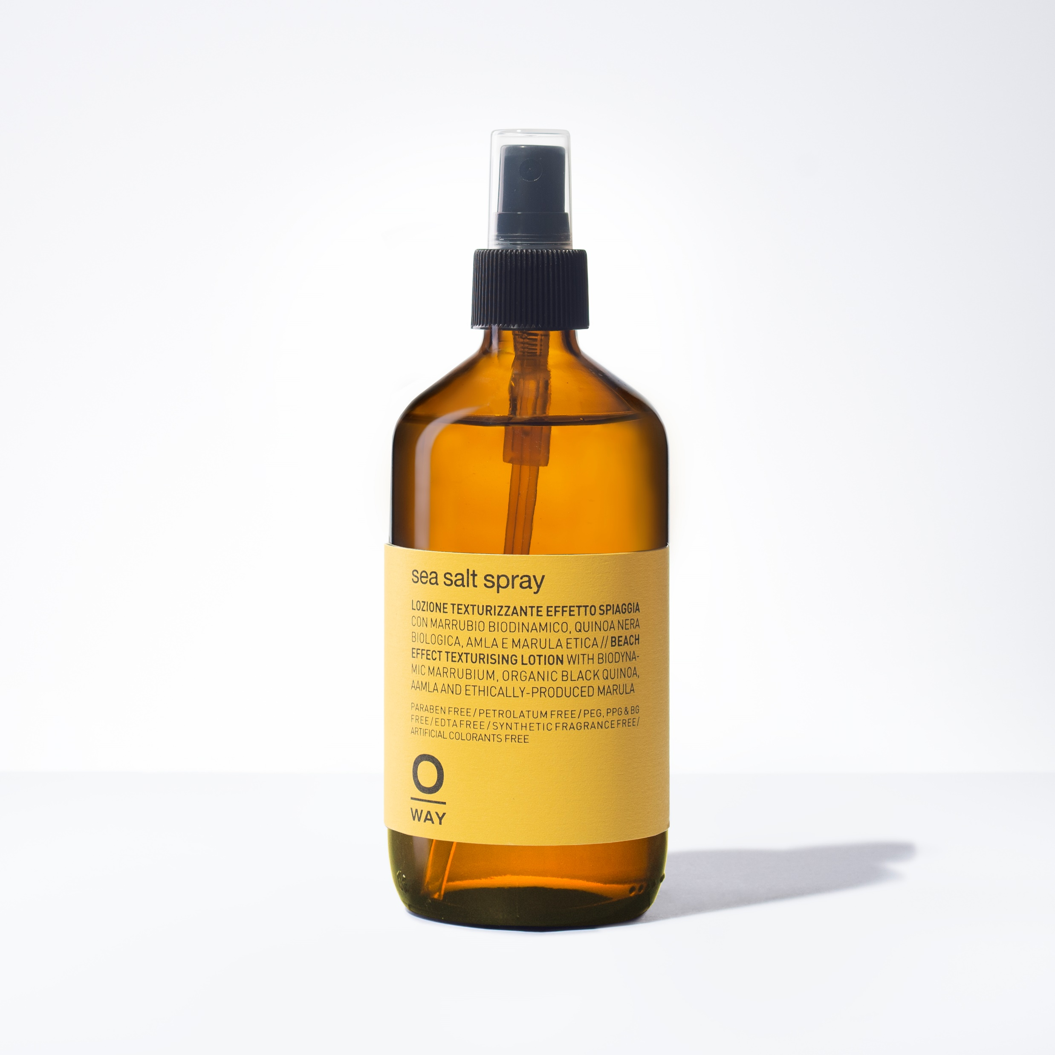
SEA SALT SPRAY
For Messy, Tousled Looks
HOLD 2.0
SHINE 0.0
+ TEXTURIZING SPRAY
+ PERFECT BEACH WAVES OR TOUSLED HAIRSTYLES
+ LIGHT SHINE / LIGHT HOLD
+ GREAT FOR UNSTRUCTURED STYLES
DID YOU KNOW: Ideal for those who shampoo everyday, as it keeps the hair structure moisturized.

Slide 13
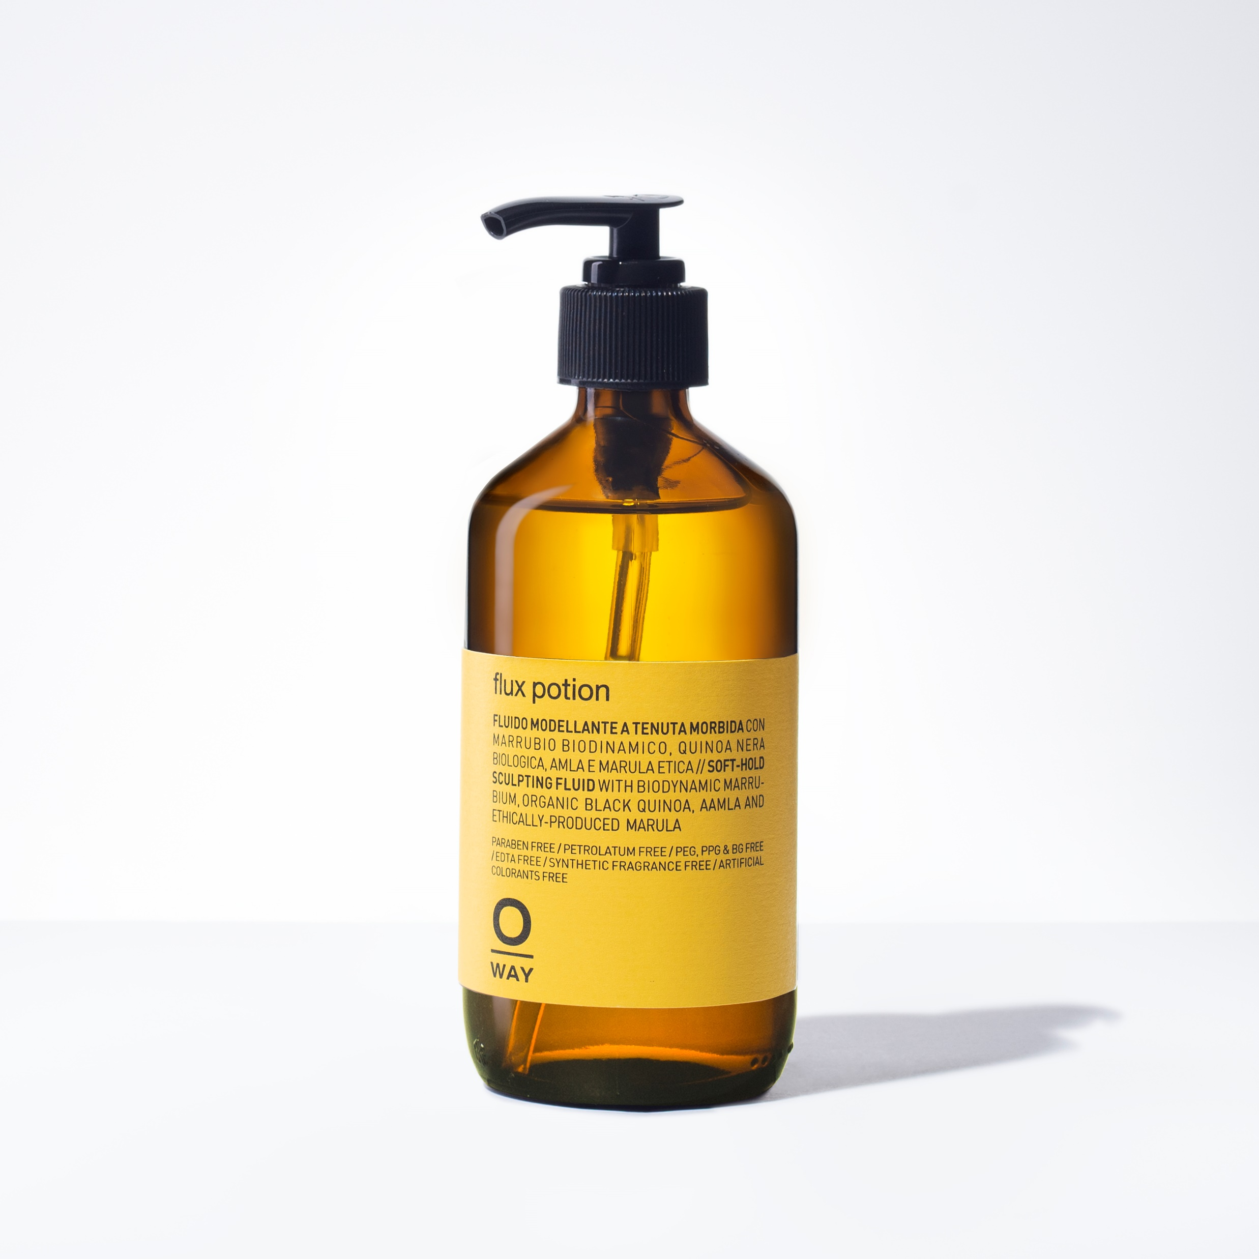
FLUX POTION
Flexible, Voluminous Looks Without Residue
HOLD 3.0
SHINE 3.0
+ FOR FULL, FLEXIBLE STYLES
+ VOLUMINOUS BLOWOUTS
+ MEDIUM SHINE / MEDIUM HOLD
+ GREAT REPLACEMENT FOR MOUSSE
DID YOU KNOW: Can be mixed with CURLY POTION to give hold and softness to curly hair.

Slide 14
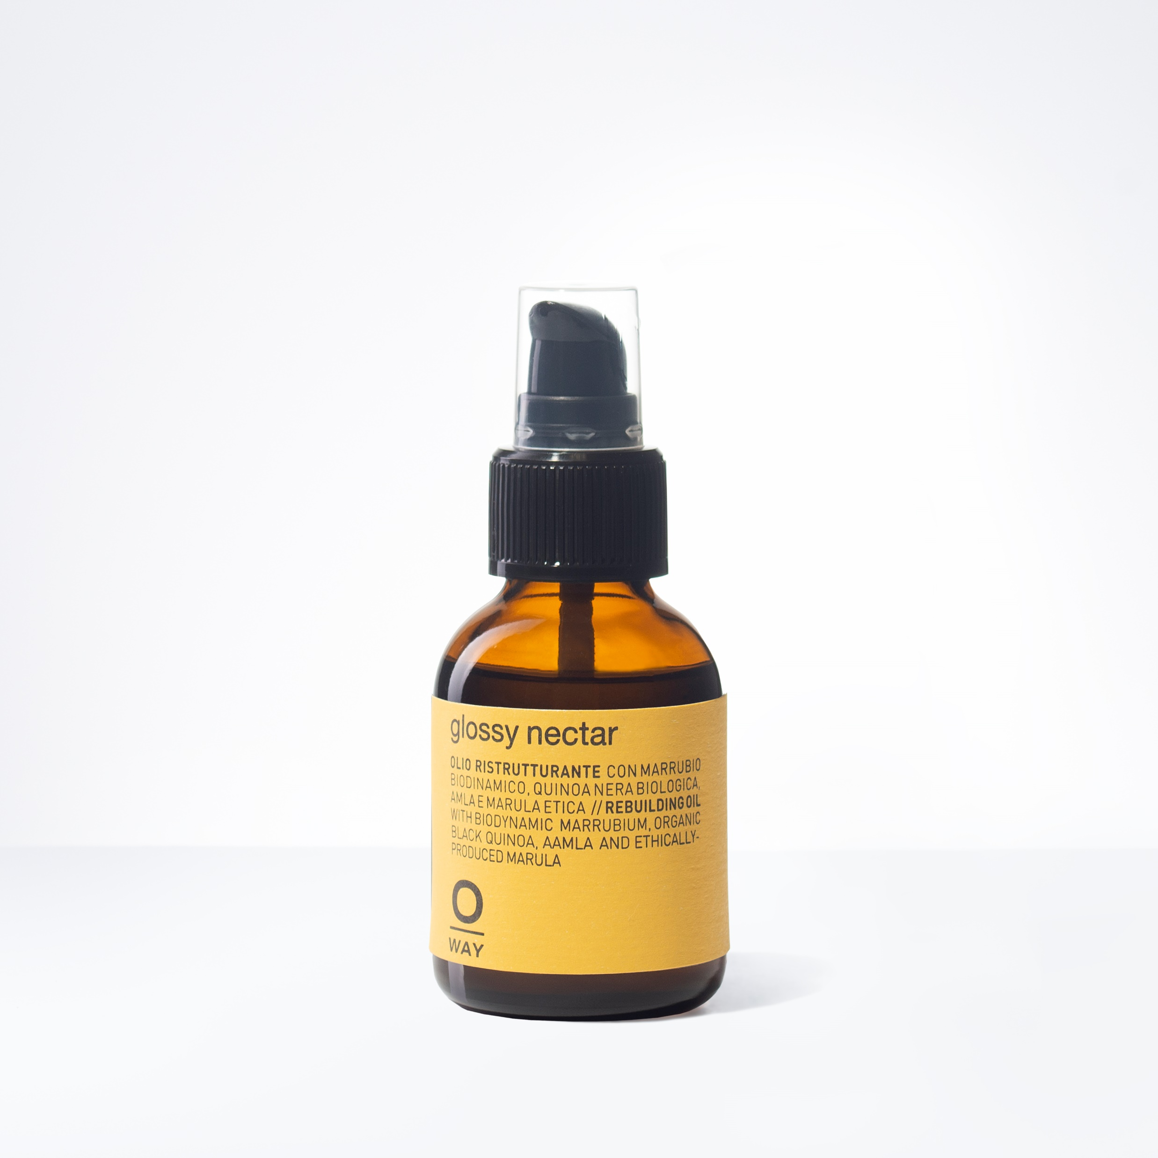
GLOSSY NECTAR
Repair & Add Shine to Dry, Damaged Hair
HOLD 0.0
SHINE 4.0
+ CUTS DOWN DRYING TIME
+ INCREASES MANAGEABILITY
+ REPAIRS & ADDS SHINE TO HAIR
+ GREAT FOR PRE & POST BLOW DRY
DID YOU KNOW: If mixed with CURLY POTION, it gives shine to curly hair, offering greater frizz control.

Slide 15
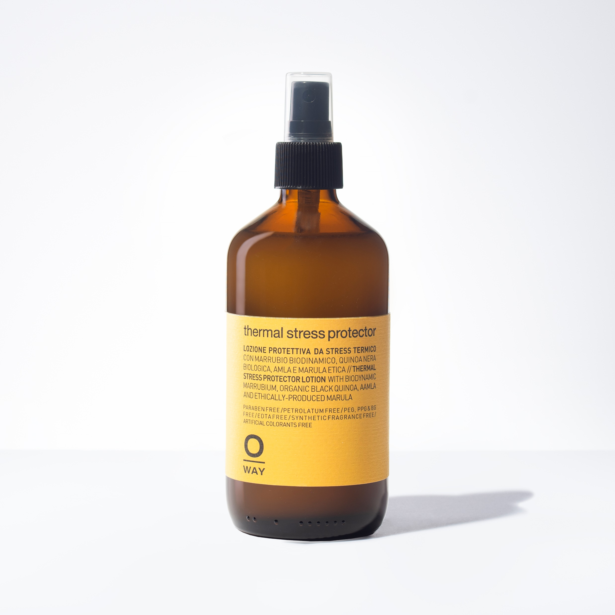
THERMAL STRESS PROTECTOR
Guards Against Heat from Hot Tools
HOLD 4.0
SHINE 4.0
+ MEDIUM HOLD SPRAY
+ GUARDS UP TO 437 DEGREES
+ ADDS LONGEVITY TO HAIR STYLES
DID YOU KNOW: If sprayed on palm and mixed with BOHO POMADE, it defines wavy hair.

Slide 16
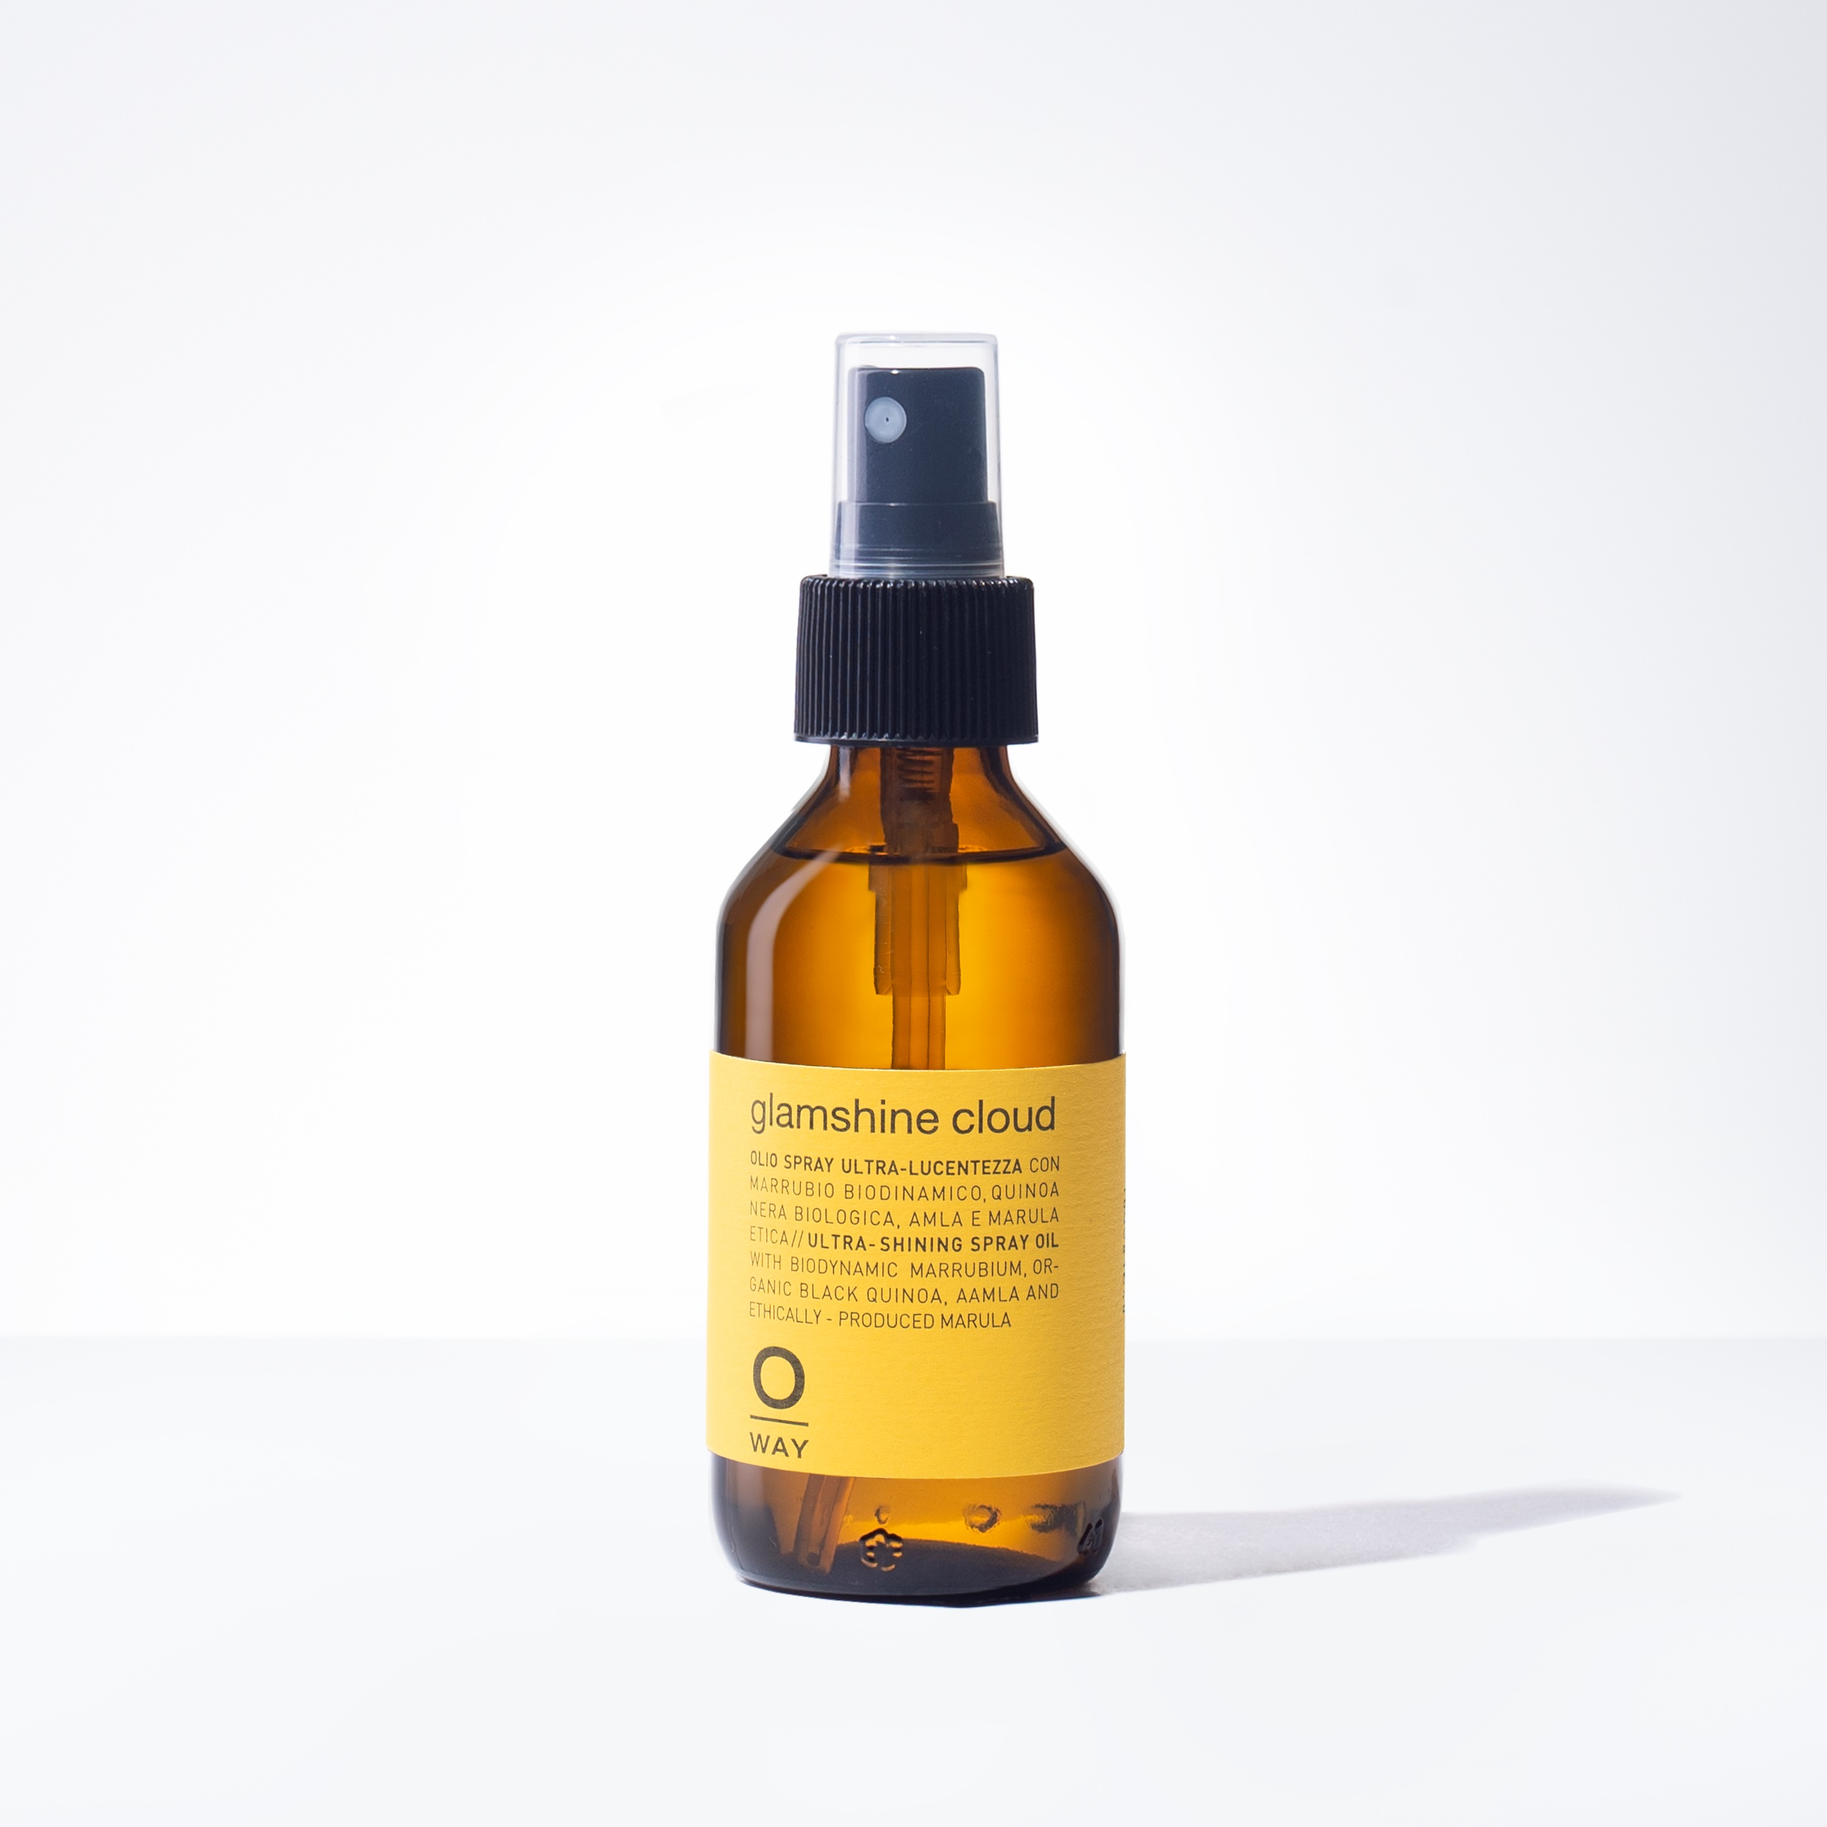
GLAMSHINE CLOUD
Light Finishing Spray for Adding Extra Sheen
HOLD 0.0
SHINE 6.0
+ NO HOLD
+ GREAT FINISHING SPRAY
+ TAMES FLY AWAYS
+ ADDS EXTRA SHIMMER + SHINE
DID YOU KNOW: If sprayed on palm and mixed with BOHO POMADE, it defines wavy hair.

Slide 17
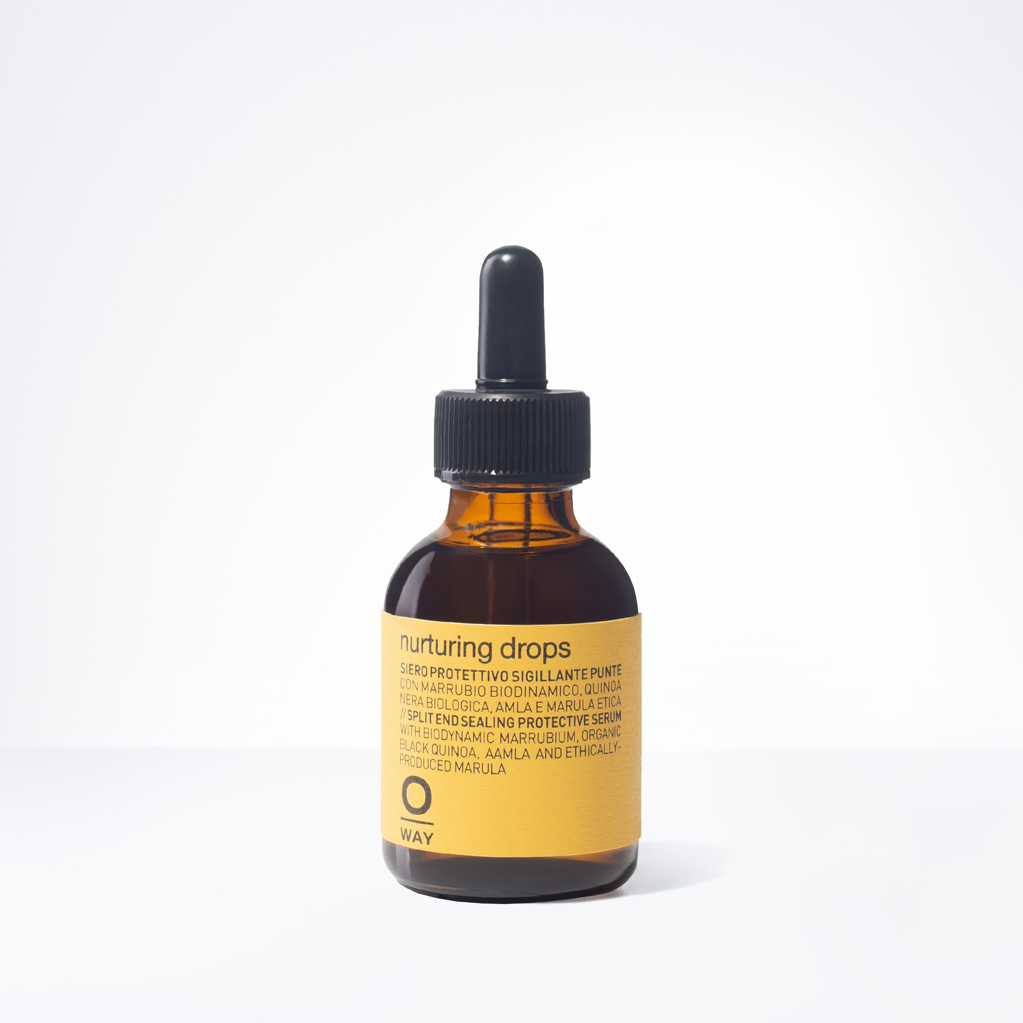
NURTURING DROPS
Ultra Concentrated Drops for Split Ends
HOLD 0.0
SHINE 5.0
+ ULTRA CONCENTRATED
+ SEALS SPLIT AND/OR DAMAGED ENDS
+ ADDS INTENSE SHINE
+ PROTECTS HAIR FROM HEAT
DID YOU KNOW: Speed up drying time on thick, wavy and frizzy hair.

Slide 18
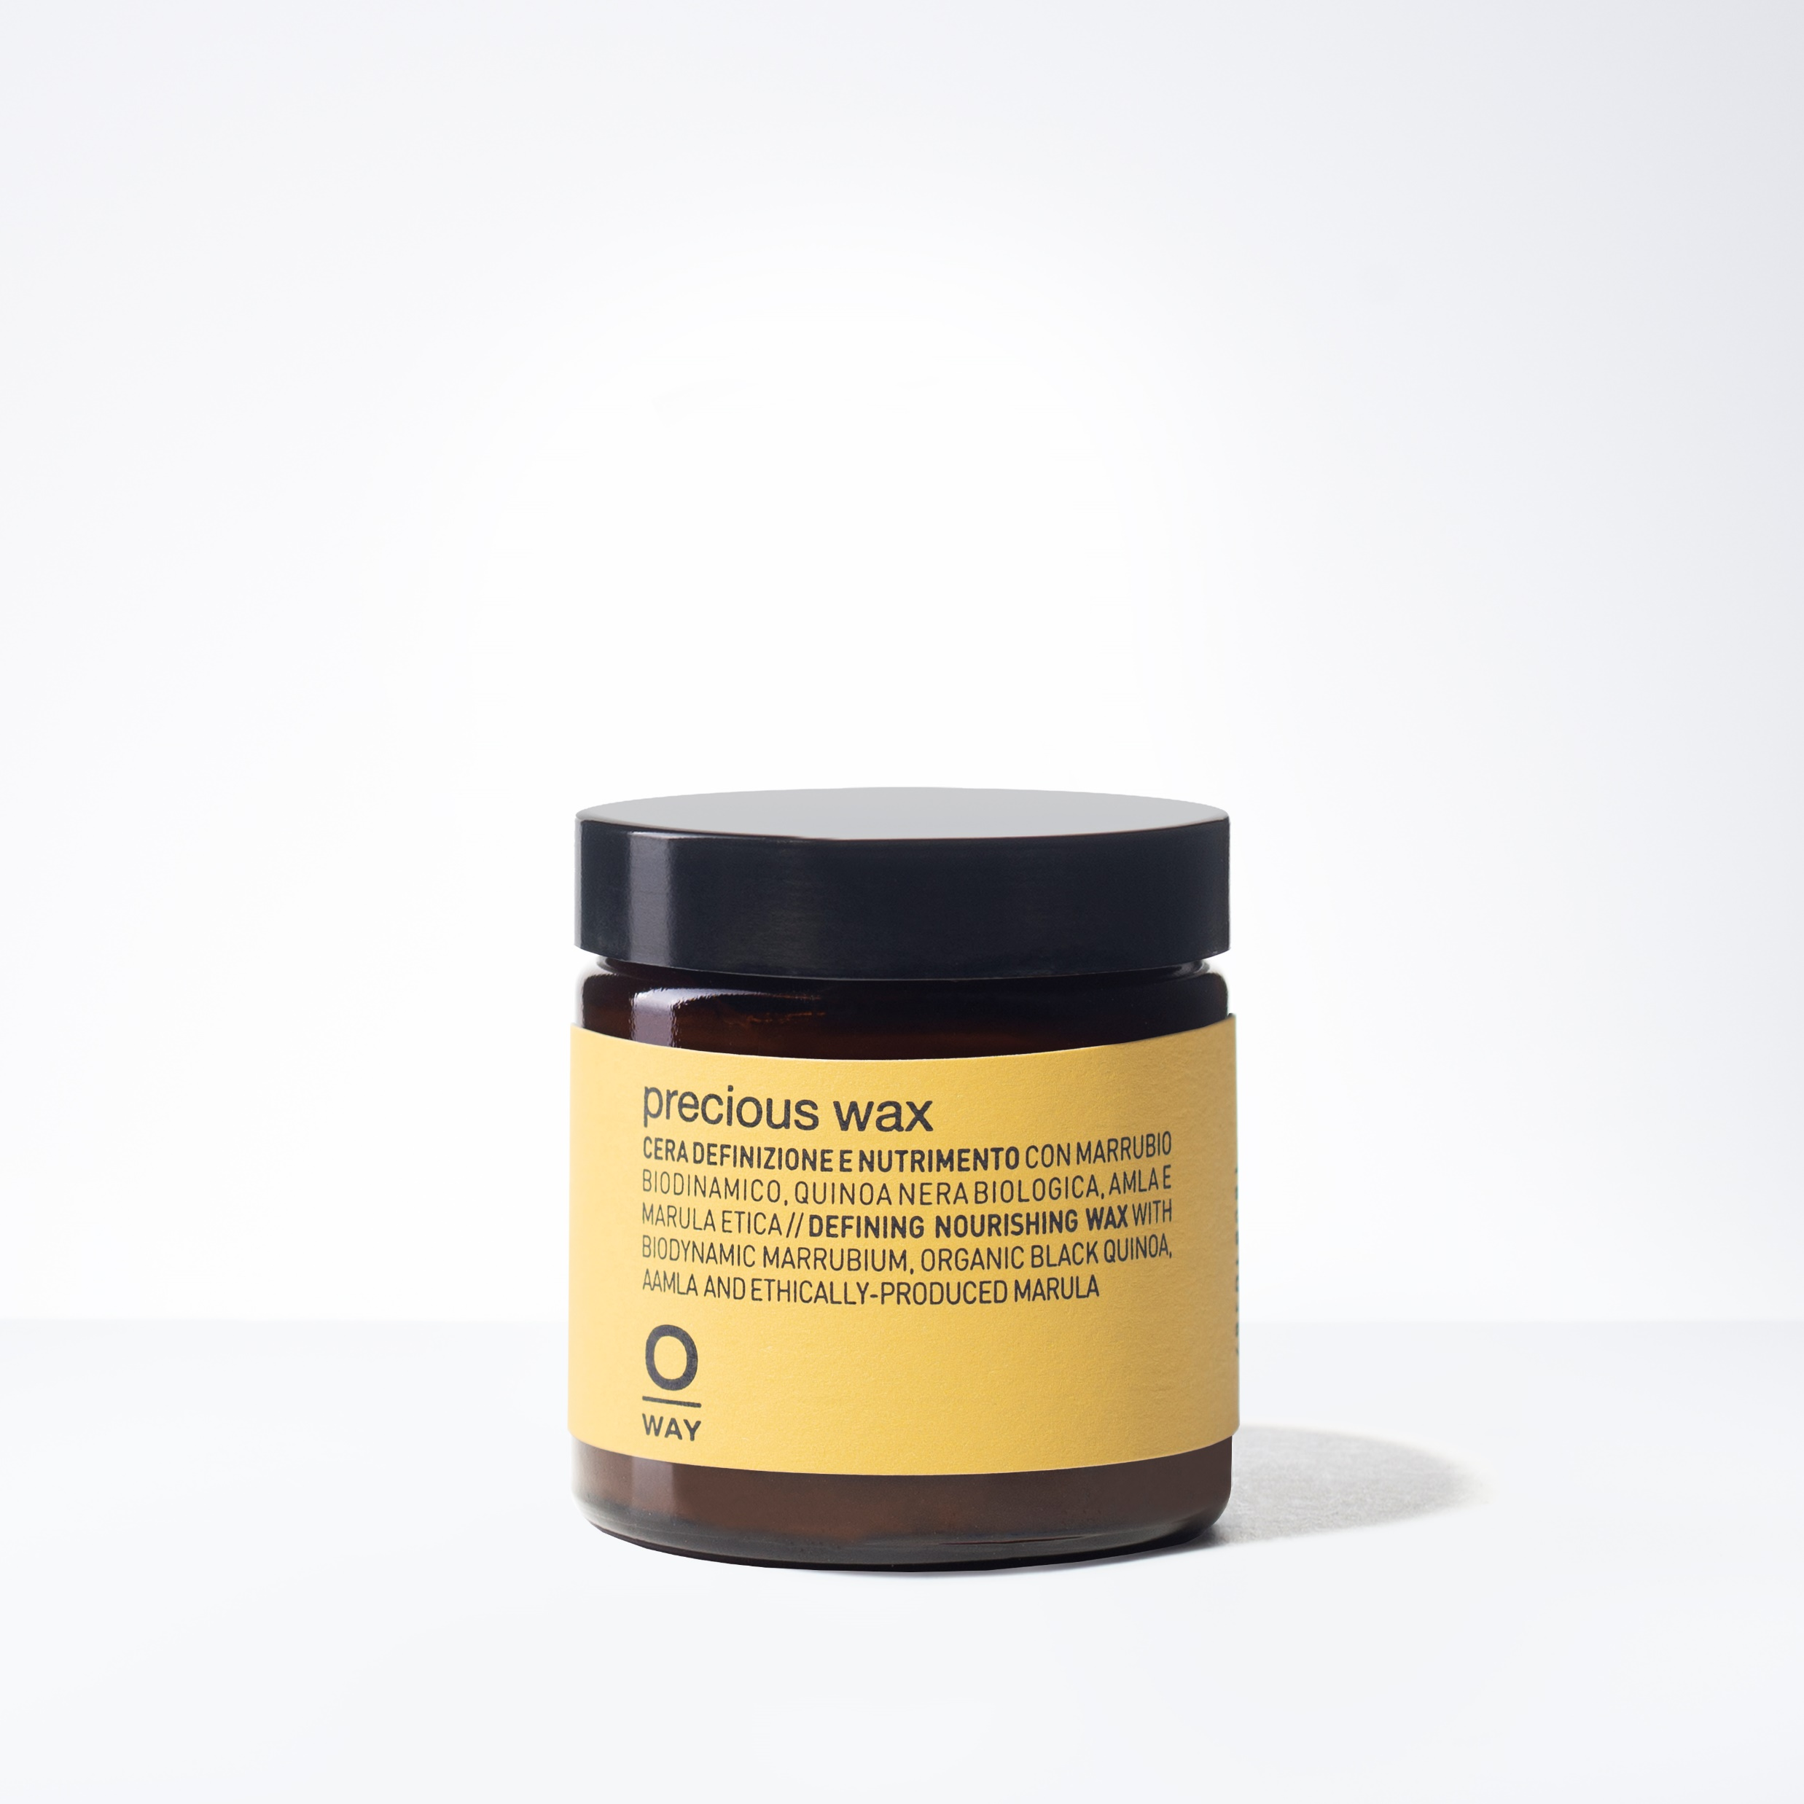
PRECIOUS WAX
Multifunctional, Zero Hold Shine Wax
HOLD 0.0
SHINE 3.0
+ MULTIFUNCTIONAL WAX
+ ADDS SHINE WITH A SOFT DEFINITION
+ DECREASES VOLUME
+ CAN BE USED AS HAND/LIP BALM
DID YOU KNOW: Its natural formula is ideal to nourish lips, hands and feet.

Slide 19
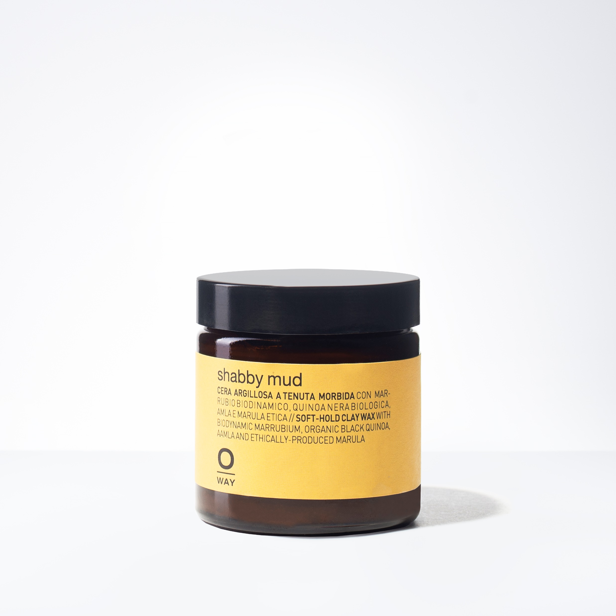
SHABBY MUD
Medium Hold Styling Clay
HOLD 2.0
SHINE 0.0
+ MEDIUM TO SOFT HOLD CLAY WAX
+ MATTE FINISH
+ ADDS STRUCTURE TO MESSY LOOKS
+ GREAT FOR CREATING “NEXT DAY” HAIR
DID YOU KNOW: Sunflower oils have a protective and brightening action on hair.

Slide 20
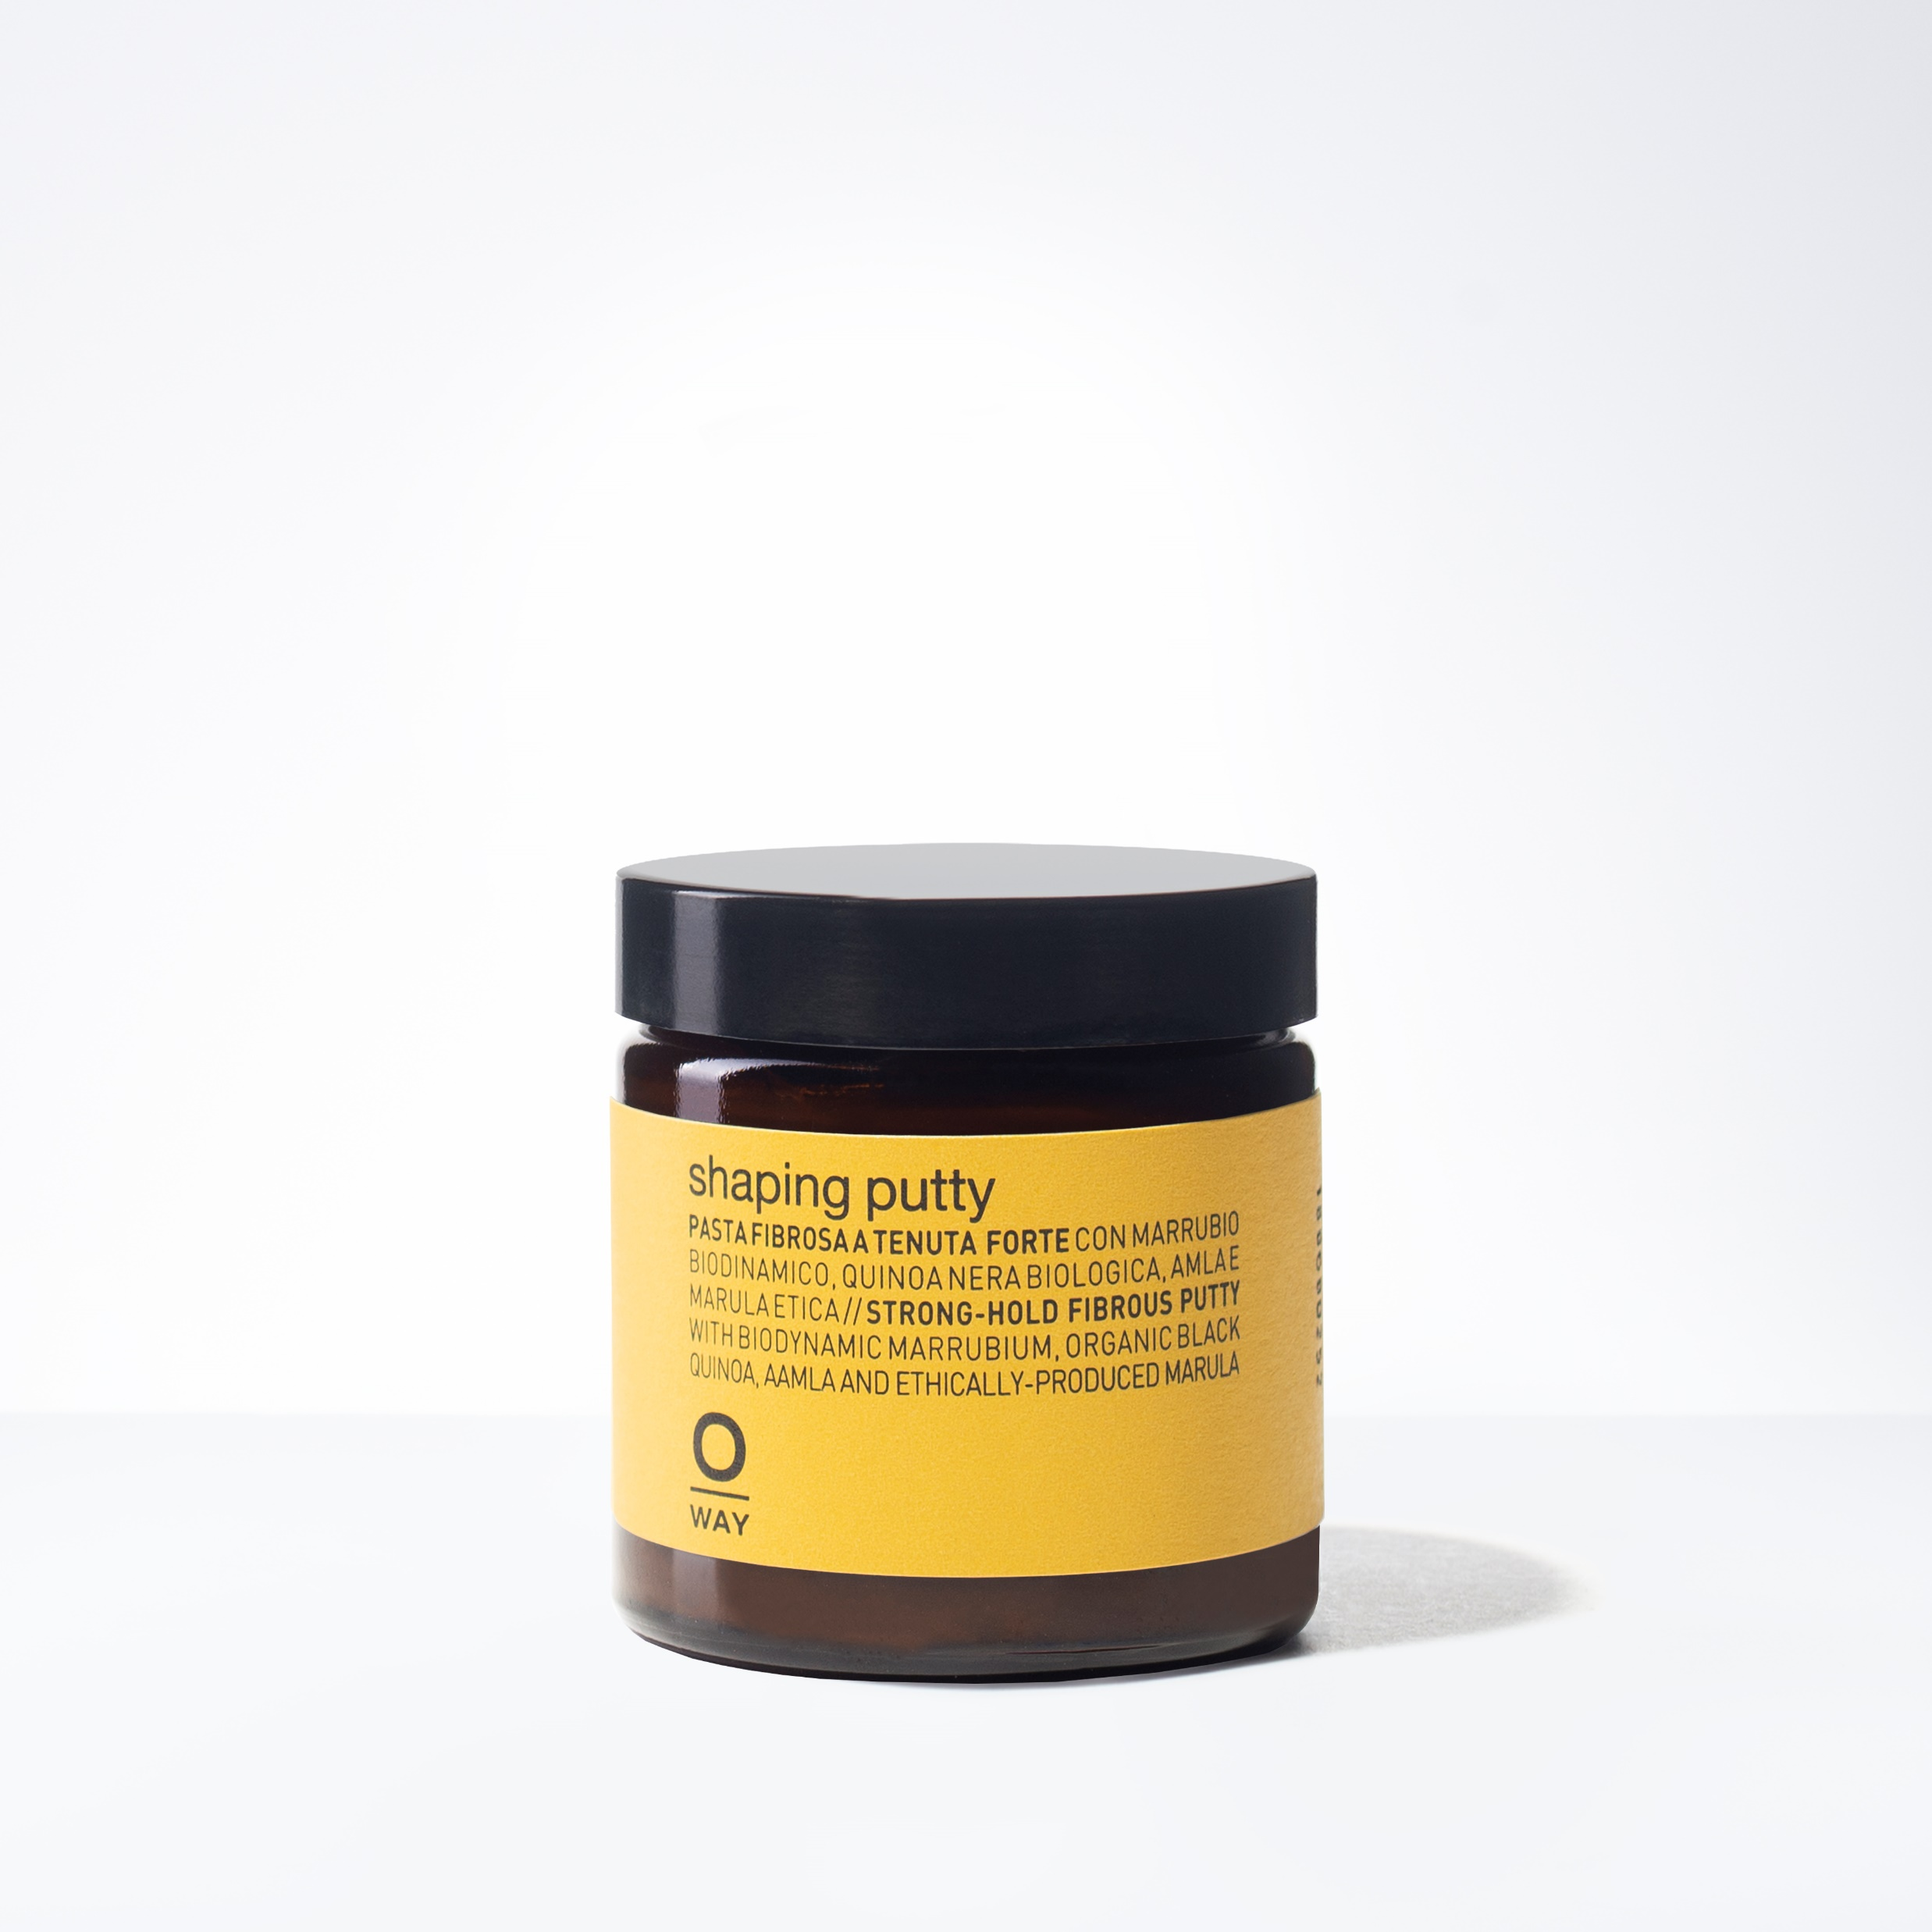
SHAPING PUTTY
Perfect Putty for Sculpting Highly Defined Hair
HOLD 5.0
SHINE 2.0
+ STRONG FIBER WAX
+ LIGHT SHINE
+ FOR DEFINED, SCULPTED LOOKS
+ CAN BE USED AT ROOTS FOR VOLUME
DID YOU KNOW: If cocktailed with PRECIOUS WAX, it heightens shine.

Slide 21

BOHO POMADE
Versatile Pomade for Curls & Piece-y Looks
HOLD 4.0
SHINE 2.0
+ MEDIUM HOLD POMADE
+ SEPARATION AND DEFINITION
+ GREAT FOR MEDIUM-SHORT STYLES
DID YOU KNOW:If mixed with GLOSSY NECTAR, it becomes extremely soft & sculpting, ideal for wavy & frizzy hair.

Slide 22
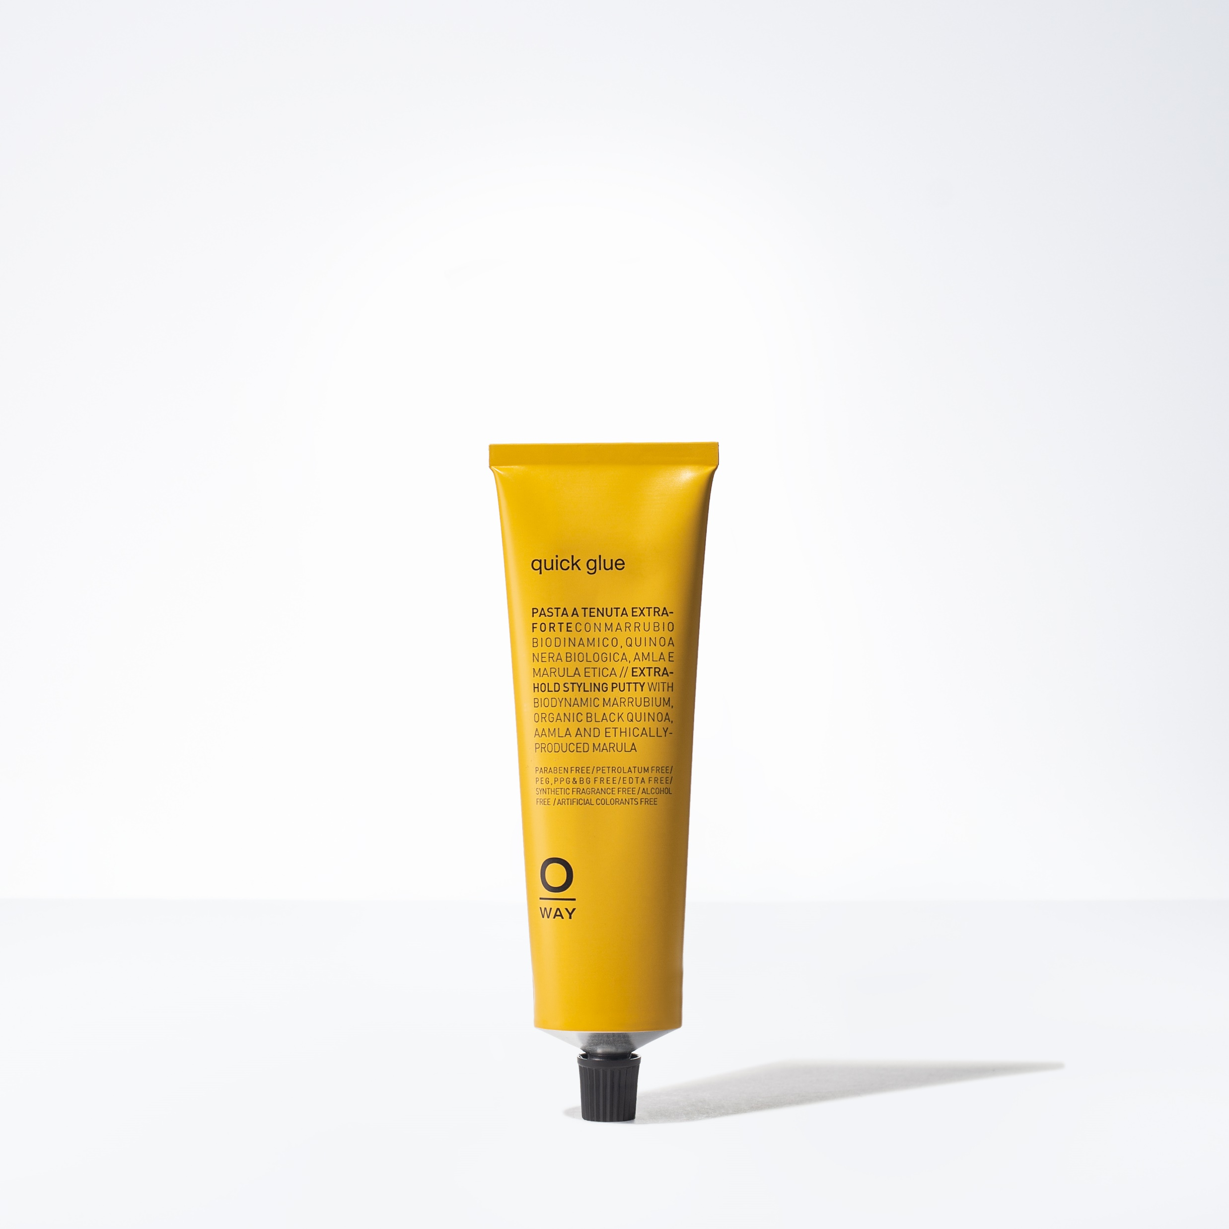
QUICK GLUE
For Extremely Defined Hair Styles
HOLD 6.0
SHINE 1.0
+ EXTRA STRONG HOLD
+ MATTE FINISH
+ IDEAL FOR SHORT TO MEDIUM HAIR
+ GREAT FOR MOHAWKS, DEFINED LOOKS
DID YOU KNOW: Can be used to obtain static effects, such as crests and locks.

Slide 23
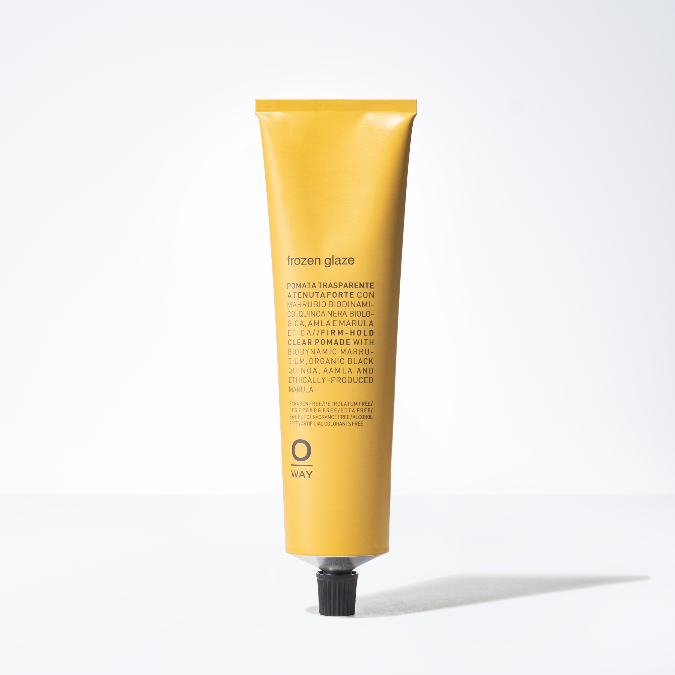
FROZEN GLAZE
Perfect for Creating Sleek, Wet Looks
HOLD 5.0
SHINE 5.0
+ STRONG HOLD FINISH
+ HIGH SHINE
+ PERFECT FOR SLEEK LOOKS
+ USE ON WET HAIR FOR HIGH SHINE
+ ON DRY HAIR, ACTS LIKE A WAX
DID YOU KNOW: If mixed with BIO RICH WATER, you can obtain a softer consistency suitable for thinner hair types.

Slide 24
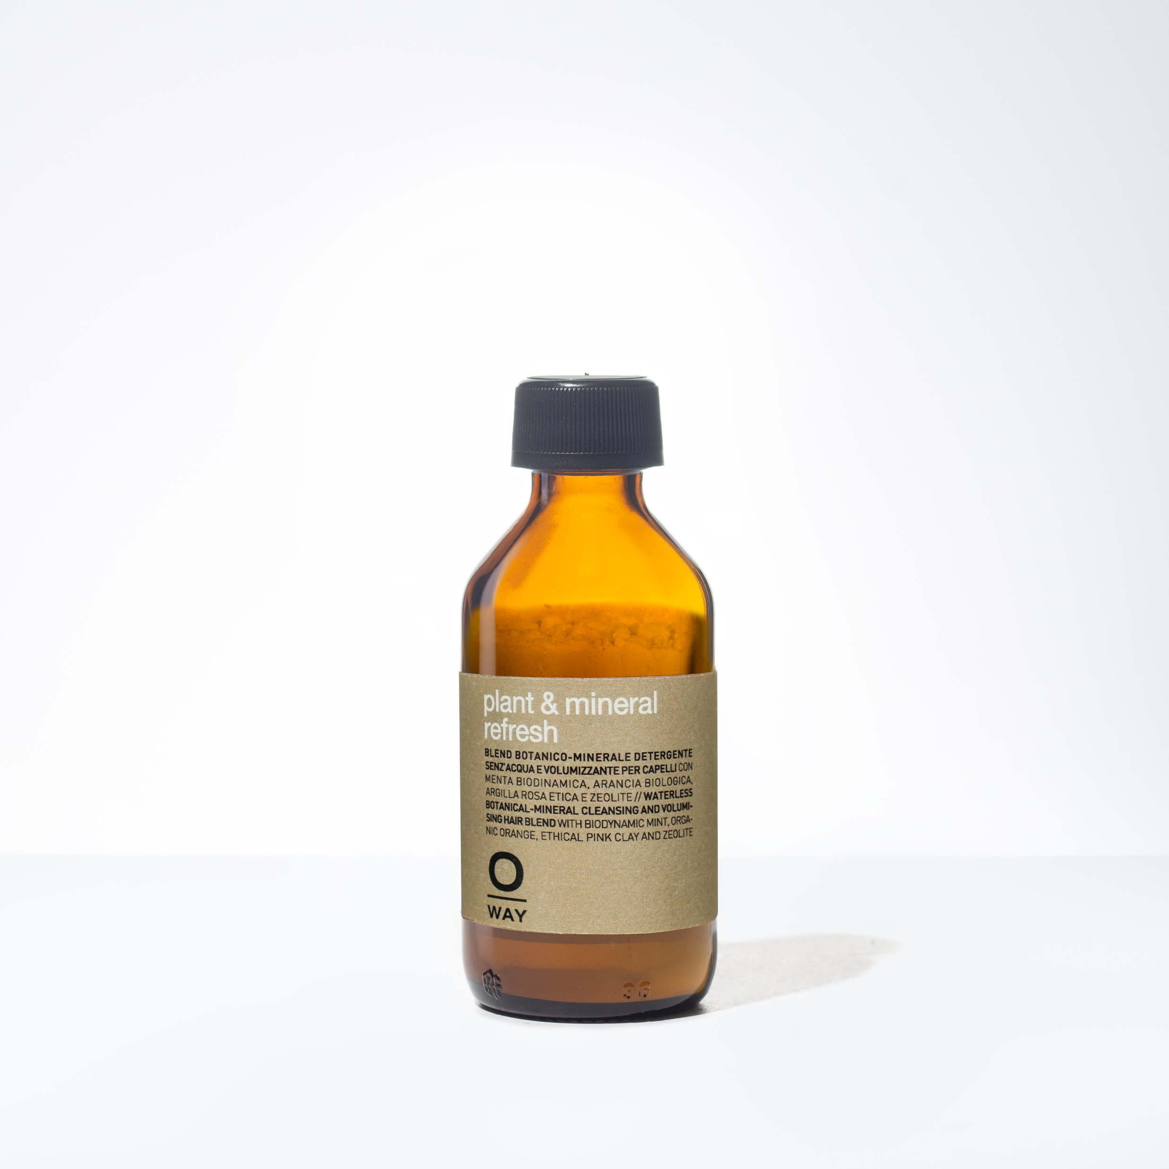
PLANT & MINERAL REFRESH
100% Organic Dry Shampoo
+ DETOXES & REFRESHES THE SCALP
+ ABSORBS EXCESS OIL & TOXINS
+ VOLUMIZER + TEXTURIZER
+ DEODORIZER

Slide 25
STYLING IN REVIEW:
WAXES, MUDS & POMADES to define, separate, support and texturize / NECTARS, DROPS & LOTIONS to nourish, rebuild, and give hair a shiny, seductive look / GLAZES, GLUES, SPRAYS & HEAT PROTECTORS to hold, sculpt and give structure and support

Slide 26
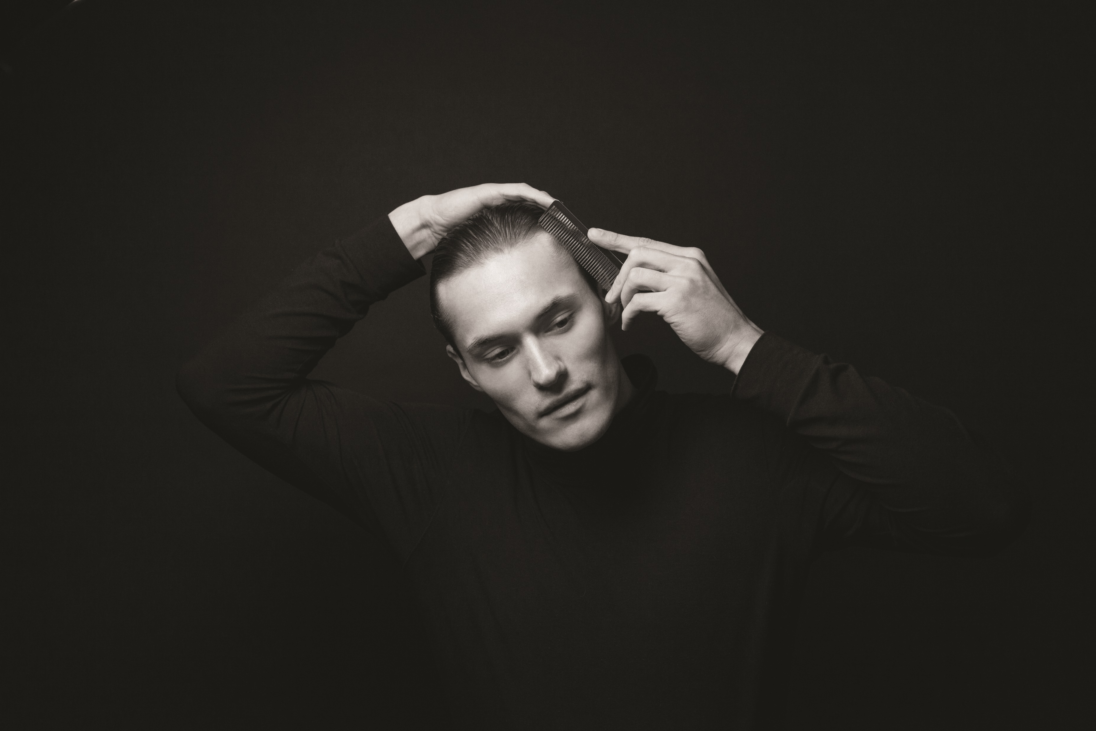

Men’s Collection

Slide 27
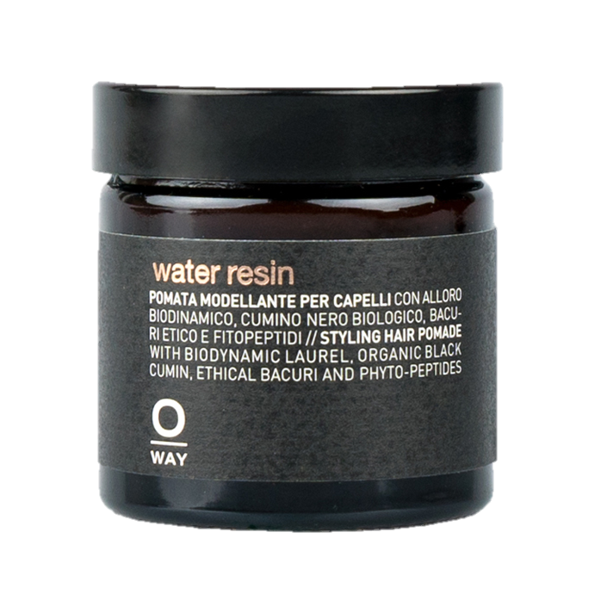
WATER RESIN
+ MEDIUM-HOLD POMADE
+ SATIN FINISH
+ WATER-BASED
HOLD 3.0
+
HYDRATES AND RE-PLUMPS THE HAIR USING PHYTO-PEPTIDES
SHINE 3.0

Slide 28
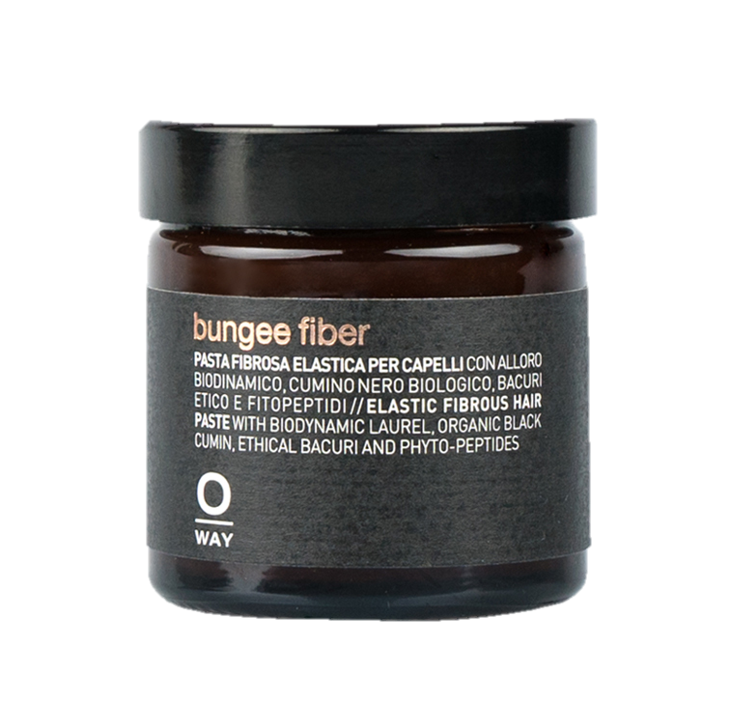
BUNGEE FIBER
+ STRONG-HOLD FIBROUS PASTE
+ GREAT FOR WAVY OR CURLY HAIR
+ GIVES AMPULE SHAPE AND VOLUME
HOLD 5.0
+
SHINE 2.0
ADDS NATURAL MOISTURE FROM BIODYNAMIS LAUREL, ORGANIC BLACK CUMIN AND ETHICAL BACURI

Slide 29
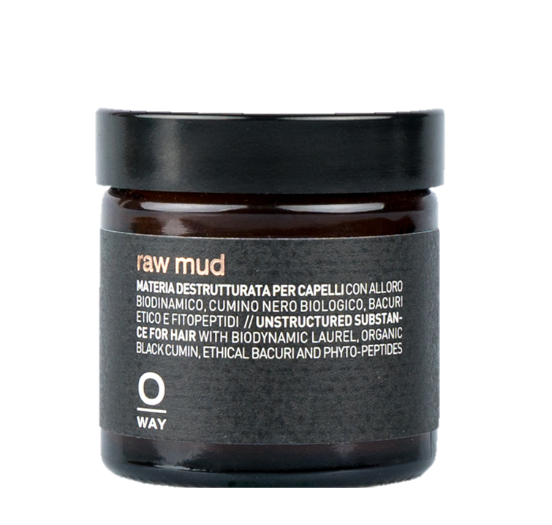
RAW MUD
+ STRONG-HOLD WAX
+ MATTE FINISH
+
GREAT FOR CREATING SCULPTED LOOKS ON MEDIUM AND THICK HAIR
HOLD 6.0
+
CONDITIONS THE HAIR WHILE PROTECTING IT FROM EXTERNAL AGGRESSORS
SHINE 0.0

Slide 30




The Organic Way
BIODYNAMIC
INGREDIENTS
GREEN
CHEMISTRY
FAIR TRADE
NETWORKS
SUSTAINABLE
DEVELOPMENT

Slide 31
Social Media
HASHTAGS
#SimplyOrganicBeauty
#OrganicWay
#Oway
#OwayOrganics
#HolisticHairTribe
INSTAGRAM
@SimplyOrganicOfficial
@OwayOrganics
@HolisticHairTribe

